Slide 1

Phonics Screening Check

Slide 2
What is the phonics screening check?
The phonics screening check, or phonics screening test, is an informal test that year 1 pupils will need to undertake. This test is part of their education in phonics, which is a method through which children are taught how to read and write, and it tests them on their ability to read and decode a series of words.

Slide 3
How long should it take?
According to the Department for Education, it's a short, light-touch assessment that should take less than ten minutes to complete. It usually takes place on a one-to-one basis between a pupil and their class teacher.
Mrs Gowdy, Ms Wood and Mr Houlsby will be administering the test this year.

Slide 4
What will children be tested on in the phonics screening check?
The phonics screening check assesses children on how well they can decode certain words.
Decoding means sounding out an unfamiliar written word. To do this, children will need to be able to recognise letters and the sounds that they represent. This is an important part of achieving reading fluency!

Slide 5
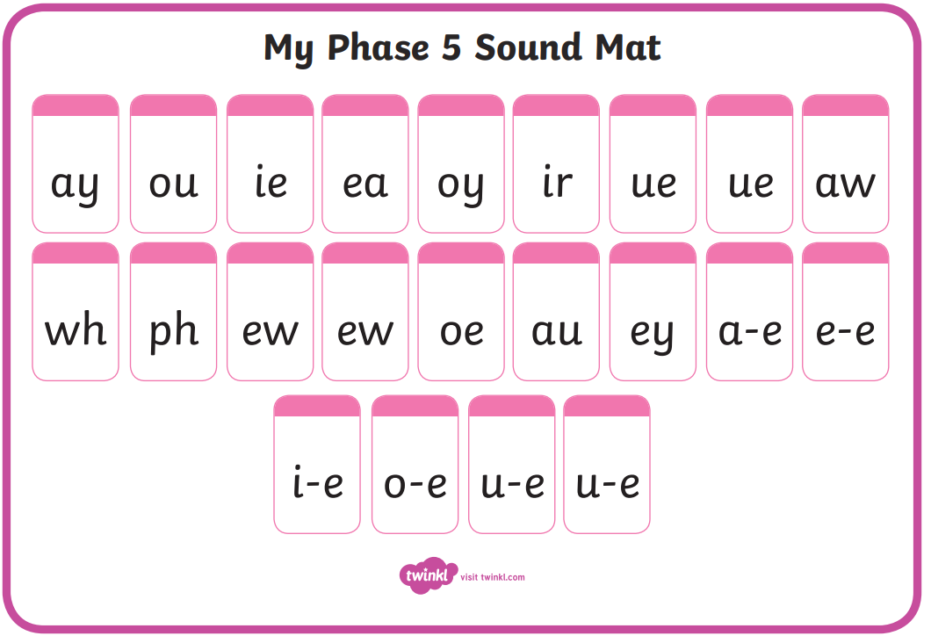
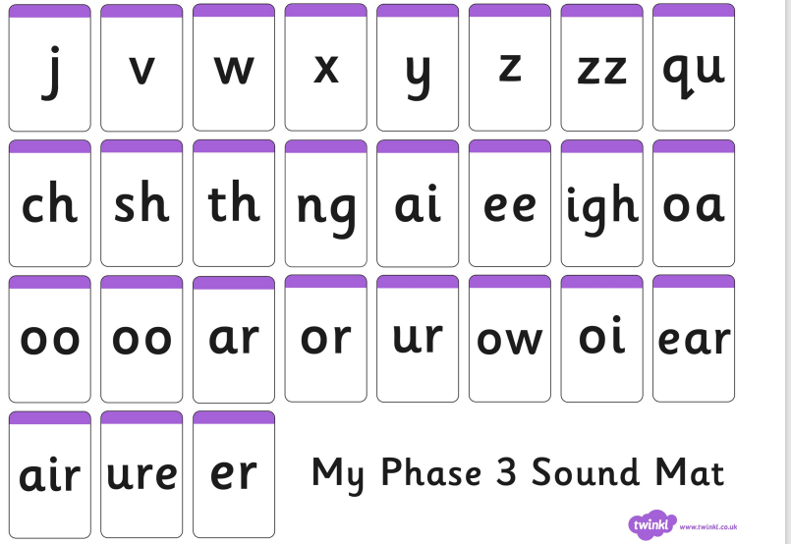
Phase 3 and 5 sounds:

Slide 6
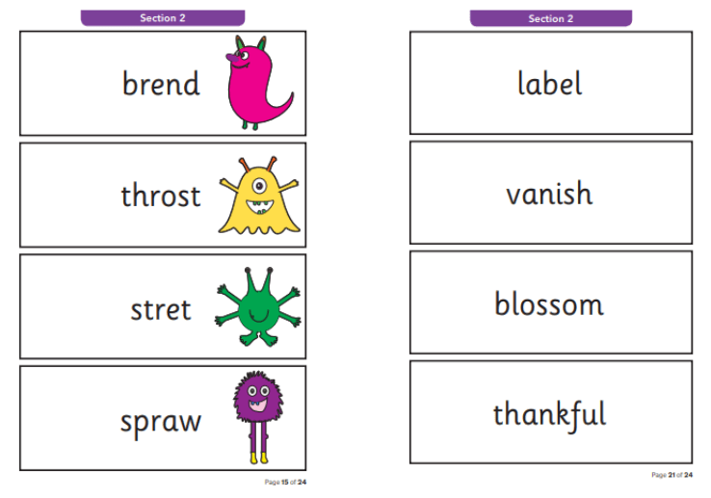
During the check, children will be asked to decode a series of 40 different words.
While most of these will be real words, there will also be some pseudo-words mixed in. These are sometimes known as alien words, and they will be accompanied by an image of an alien to help children identify them.
These words are phonetically similar to real words, but don’t have any meaning. They’re included in the check so that children will need to use their decoding skills and won’t be able to rely on memory alone.

Slide 7
This is what the words will look like:
alien words real words

Slide 8
The screening check has 2 distinct sections
In Section 1, children will be encouraged to read out words that follow simple structures such as CVC (consonant-vowel-consonant) and CVCC (consonant-vowel-consonant-consonant). These words will contain the Grapheme-Phoneme correspondences that pupils will have learned about in previous phonics levels, as well as some consonant and vowel digraphs.
In Section 2, children will have some more challenging words to decode that follow complex structures including CCVCC, CCCVC and CCCVCC. They’ll also encounter words with split digraphs, trigraphs and digraphs that can be used to represent more than one sound.

Slide 9
When is the phonics screening check?
The week beginning 12th June 2023
This means you have plenty of time to practice and help your child get ready for it. ☺
What is the pass mark for the phonics screening check?
To pass the phonics screening check, children will need to correctly decode 30-32 of the 40 words that they will be shown. This standard was set in 2013 and continues to be valid today.

Slide 10
What happens if my child fails the phonics screening check?
Some children might find the phonics screening check slightly trickier and may have trouble decoding some of the words. So what happens if your child doesn't pass the screening check?
If a child does not achieve the required passing grade during the phonics screening test, they will be given extra support over the course of the next school year to improve their abilities at reading and decoding words. At the end of year 2, they will then be able to retake the screening test.
As the screening check isn’t a formal assessment, failing it will not prevent a child from progressing into year 2

Slide 11
How do I prepare my children for the phonics screening test?
There are plenty of activities, exercises and simple things you can do to support them both in school and at home, such as:
Reading with your child: Taking some time out every day to read with your child can be greatly beneficial for their phonics learning and screening preparation. You could try reading some unfamiliar books and stories with them as well as ones they’ve already read, as this will expose them to some new, unfamiliar words and spellings.
Breaking down words: If you and your child come across a new word, and they’re having trouble sounding it out, try segmenting it into its different sounds with them and then blending it together again.
Brush up on phonics terms: Even though there are many confusing phonics terms, knowing about them will help you to understand what’s expected of your child and where they can improve.

Slide 12
And if a child struggles with decoding words, remember the following tips:
Don’t worry. Children learn at different rates, so relax and work at their own pace.
Be positive. The goal is to encourage children to read fluently and, once reading, to love doing it. Getting annoyed or frustrated can only be detrimental to the development of their skill.
Try another route. If a child doesn’t quite understand the word they’ve just decoded, explain its meaning.
Follow directions. The English language is read from left to right, so make sure to point out that they need to say each sound in the word from left to right.
Point and blend. Blend the sounds being read out by pointing to each letter (or letter group) while reading and running a finger under the whole word.

Slide 13
Guide to the Key Phonics Terms:
As parents, it's important to make sure that we understand the key terms in phonics so that we can carry on the good work our child has done at school at home!
1 Blend: this is when you say the individual sounds that make up a word and then merge or blend them together to say the word as used when reading.
2 Consonant: most letters of the alphabet are consonants, except for the vowels: a,e,i,o,u.
3 CVC Words: this is an abbreviation used for consonant-vowel-consonant words. It describes the order of sounds. Some examples of CVC words are: cat, pen, top, chat (because ch makes one sound).
Other similar abbreviations include:
VC (Vowel Consonant) words e.g. on, is, it.
CCVC (Consonant, Consonant, Vowel, Consonant) words e.g. trap and black.
CVCC (Consonant, Vowel, Consonant, Consonant) words e.g. milk and fast.
4 Digraph: this describes two letters which together make one sound e.g. ee, oa, ea, ch, ay.

Slide 14
There are different types of digraph:
Vowel digraph: a digraph in which at least one of the letters is a vowel: boat or day.
Consonant digraph: two consonants which can go together: shop or thin.
Split digraph (previously called magic e): two letters, which work as a pair to make one sound, but are separated within the word e.g. a-e, e-e, i-e, o-e, u-e. For example cake or pine.
5 Grapheme: it's a written letter or a group of letters which represent one single sound (phoneme) e.g. a, l, sh, air, ck.
6 Phoneme: it's a single sound that can be made by one or more letters - e.g. s, k, z, oo, ph, igh.
7 Phonics: it teaches children to listen to and identify the sounds that make up words. This helps them to read and write words.
8 Pure Sound: it's the skill of pronouncing each letter sound clearly and distinctly without adding additional sounds to the end e.g. 'f' not 'fuh.’
9 Segment: it's the opposite of blending as it means splitting a word up into individual sounds when spelling and writing.
10 Tricky Words: they're the words that are difficult to sound out e.g. said, the, because which don't follow phonics rules.
11 Trigraph: this is when three letters go together to make one sound e.g. ear, air, igh, dge, tch.
12 Vowel: the letters a, e, i, o, u

Slide 15
There are lots of fun activities and games you can try to help support your child. Try out some of the websites below:
www.twinkl.co.uk
www.phonicsplay.co.uk
www.topmarks.co.uk

Slide 16
The most important thing is:
don’t stress!
and remember to make learning fun.
If you have any questions regarding the screening check, please don’t hesitate to see a member of the Year 1 Team ☺
Have fun! ☺
Thank you for your continued support! Team Year 1

